Slide 1

It’s RRSP Time!
February 19, 2020

Slide 2
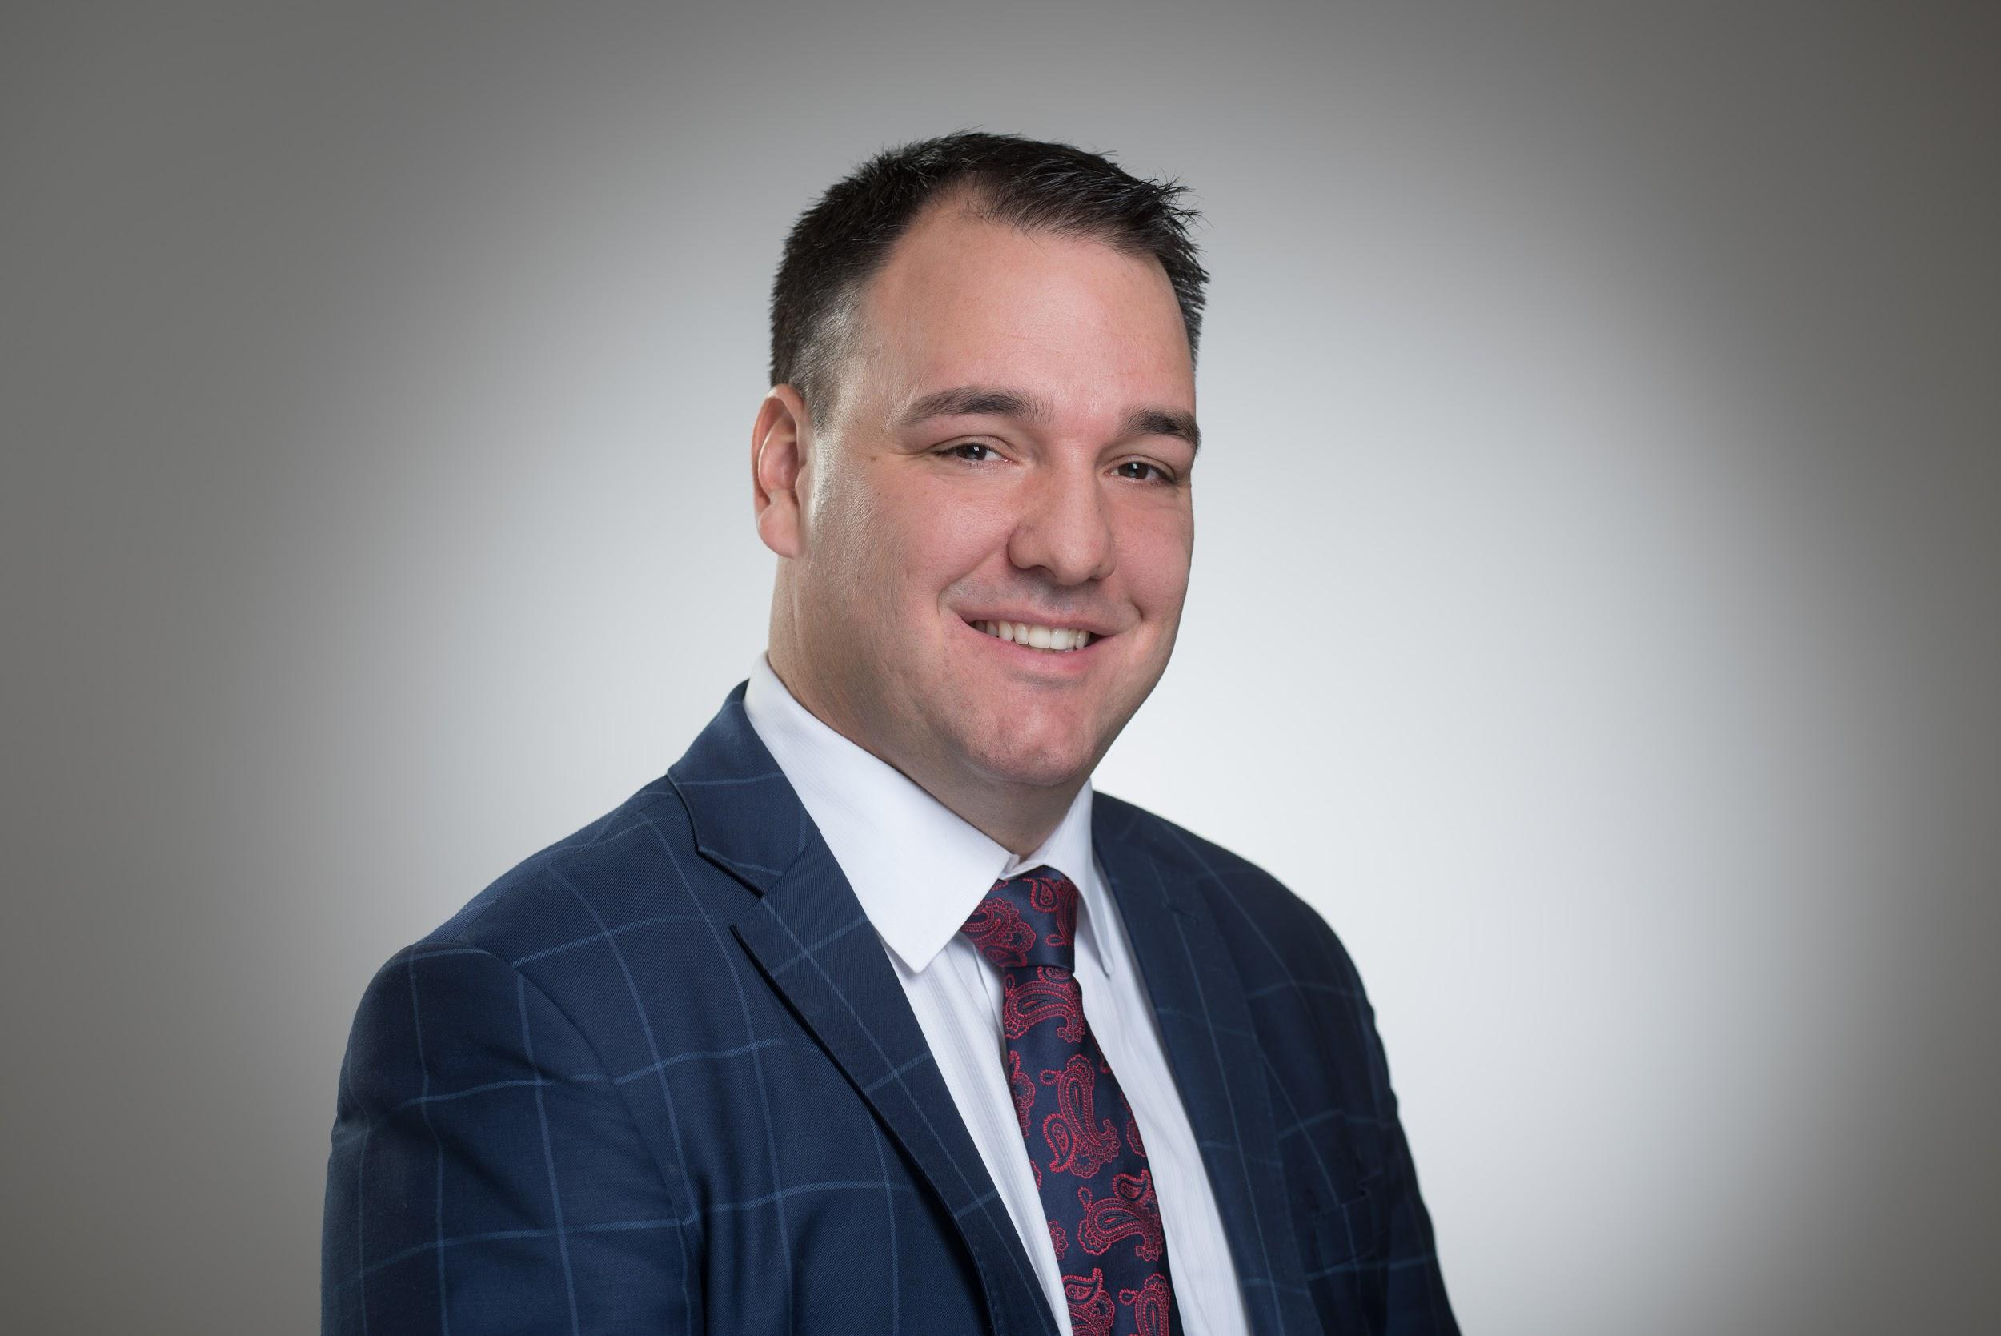



Rob Tétrault, B.A., J.D., MBA, CIM

Slide 3

Rob Tétrault, B.A., J.D., MBA, CIM
Adam W. Buss
Wealth & Estate Planning Specialist
CFP® RRC® FCSI® CLU®

Slide 4




The Team
The Advisory Group providing World Class Investment Solutions
Claude Tétrault
FCSI®
Derrek Funk
Jean Moquin
Karen Kazina
CIM®, MTI®
Investment Associate
Over 40 years of experience in the Investment Industry
Investment Advisor
Over 10 years of experience in the Financial Services Industry
Business Development Associate
Over 5 years of experience in the Digital Marketing Industry
Investment Advisor Assistant
Over 15 years of experience in the Financial Services Industry

Slide 5




The Team
The Advisory Group solving the financial problems you identified
Jean-Luc Laflèche
Ester Kamenz
Adam Buss
CFP® RRC® FCSI® CLU®
Keri Wersh
Associate
Over 10 years experience in Business Operations
Branch Administrator
Over 5 years of experience in the Financial Services Industry
Investment Associate
Over 20 years of experience in the Financial Services Industry
Wealth and Estate Planning Specialist
Over 16 years of experience in Wealth and Estate Planning

Slide 6
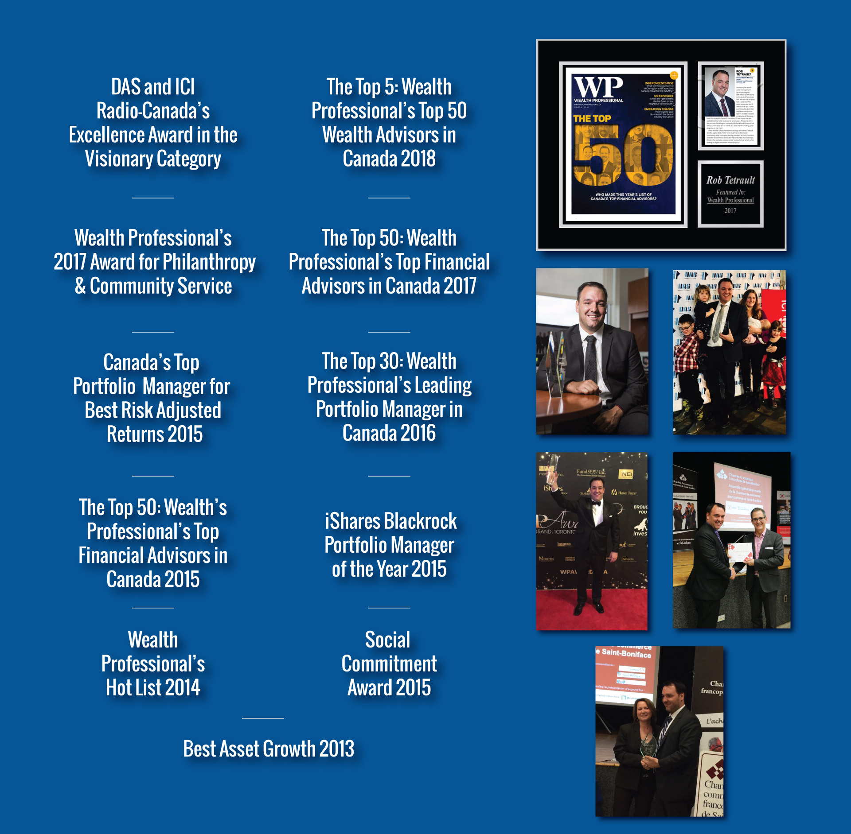

Awards
&
Accolades
Voted #2 in Wealth Professional’s 2018 List of
Top 50 Wealth Advisors in Canada.

Slide 7
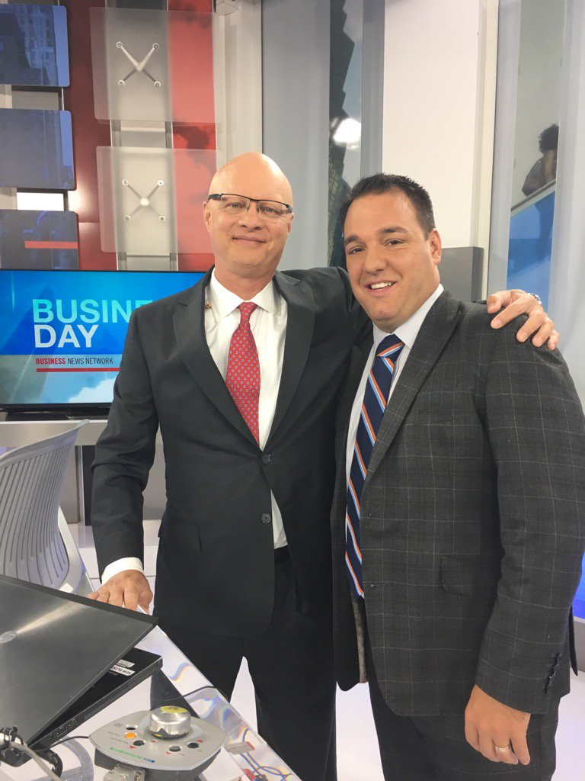
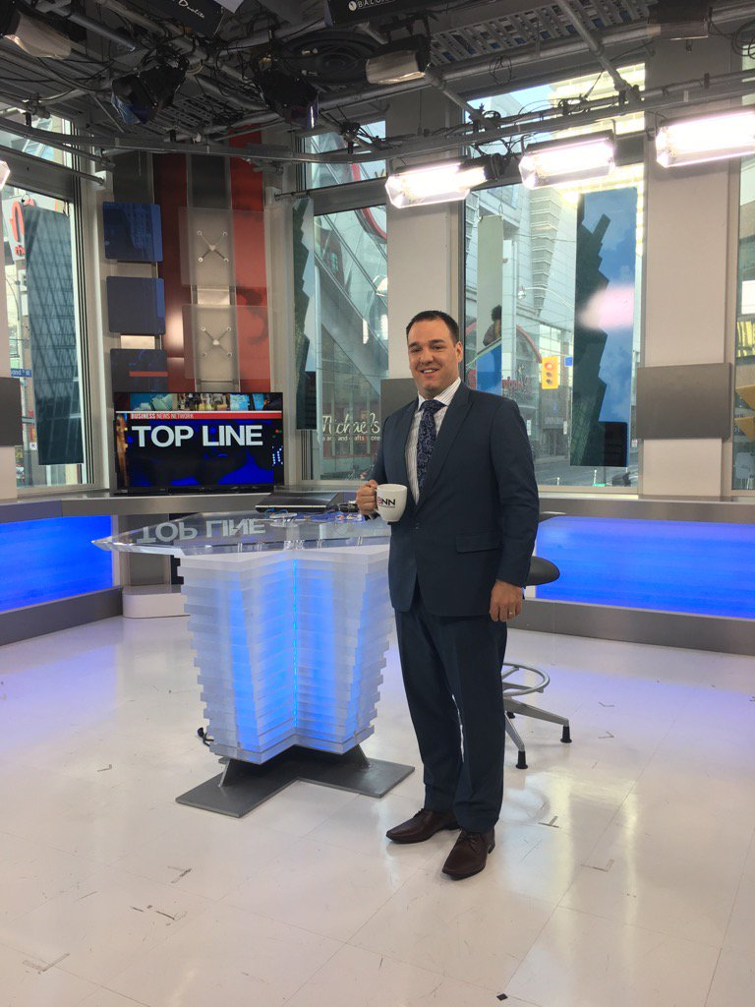
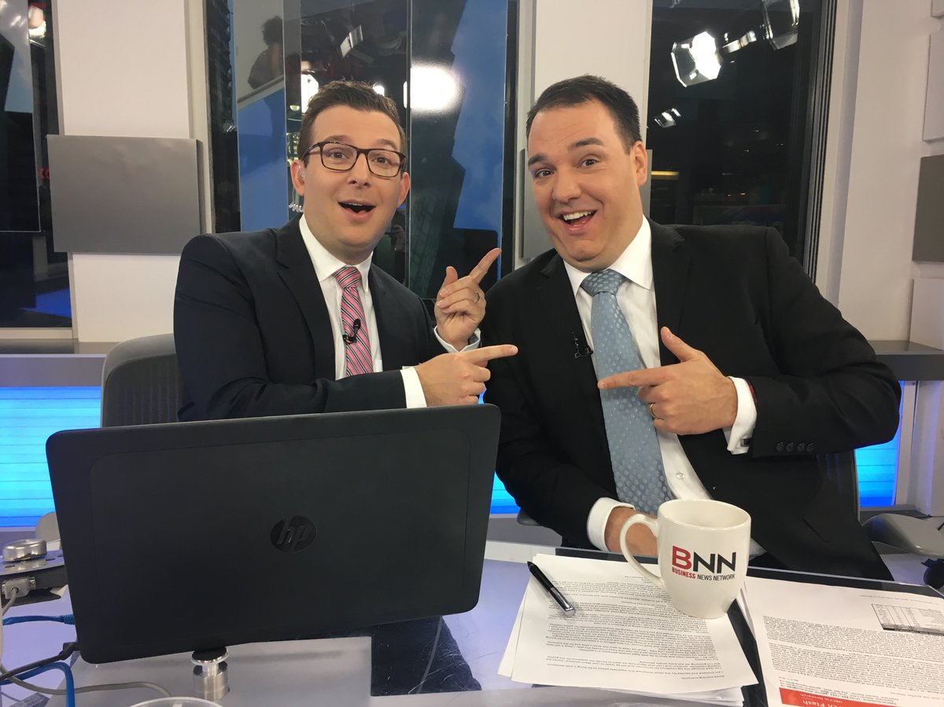
BNN
Bloomberg

Slide 8

Overview of Canaccord Genuity Group Inc.
A leading independent financial services firm with a global presence
Overview
    Strong balance sheet of C$575.6 million working capital¹
    C$61.3 billion in client assets under management and administration¹ at the end of Q4/18
    Comprehensive coverage of the major growth equity buyers – regardless of geography
    Operations in Canada, the US, the UK & Europe, the Middle East and Asia Pacific and capabilities to list companies on 10 stock exchanges worldwide
    Committed to further development in key markets and sectors successfully acquired and integrated six companies in the last ten years
Global presence
Smaller locations not shown
Calgary
Toronto
Montreal
Dublin
London
Vancouver
Nashville
Boston
Paris
Beijing
New York
San Francisco
Houston
Washington, DC
Dubai
Hong Kong
Perth
Sydney
Melbourne
Investment Banking
    193 investment bankers globally²
    FY2018: Led and participated in
    455 transactions, raising over
    C$34.5 billion for clients³
Equity Research
    134 research professionals²
    Broad industry coverage across core sectors
    ~900 companies covered
    Quest® – online valuation tool with 95% global coverage
Sales and Trading
    Equities and Fixed Income
    133 sales and trading professionals²
    10+ fixed income professionals²
    2,260+ institutions covered
    Market making
      ~2,500 companies
      10 exchanges
    C$61.3 billion in client assets under management and administration¹ at the end of Q4/18
    Approximately 300 investment advisors globally¹
    Wealth management offices across Canada, UK, Guernsey,
    Isle of Man, Jersey and Australia
    On and offshore client services
Note: All dollar amounts are stated in Canadian dollars unless otherwise indicated
1. As at 28 June 2018.
2. As at 24 September 2018.
3. Company information as at 31 March 2018. Equity offerings >$1.5m

Slide 9
RRSPs

Slide 10
What is a RRSP?
Registered Retirement Savings Account
Great savings vehicle to save towards your retirement!
Contribute with pre-tax dollars
Tax savings on contributions
Tax deferred growth

Slide 11
2019 Tax Year
RRSP Contribution Deadline – March 2, 2020
2019 RRSP Limit - $26,500 max
Personal Tax Filing Deadline – April 30, 2020*
*Exceptions for self-employed to June 15, 2020, however tax balance still owed as of April 30, 2020

Slide 12
Determining your RRSP Contribution Limit
2019 RRSP Limit - $26,500 max
18% of Prior years EARNED income
$100,000 Salary = $18,000 RRSP room
How does this change with dividend income, investment income, etc.?

Slide 13
RRSP Contribution Limit
Do you have a Defined Benefit Pension Plan?
Does your employer have a matching RRSP or DCPP plan?
Have you checked your NOA for your total unused room?
What happens if I overcontribute?

Slide 14
RRSP Tax Savings
Client has earned income of $80,000/year
RRSP Contribution Limit of $14,400
First RRSP $9389 contribution saves 37.90% or tax savings of $3558.43
Next RRSP $5011 contribution saves 33.25% or tax savings of $1666.16
*Based on combined federal/Manitoba tax rates

Slide 15
Spousal RRSPs
What is a spousal RRSP?
Proactive Income Splitting
Contributing spouse gets tax deduction
Receiving spouse claims income when withdrawn
Beware of the 3 year attribution rule
Ideal for situations with large income differences between spouses

Slide 16
Other Contribution information
Contribute to your own RRSP until the age of 71
Contribute to a spousal RRSP of younger spouse as long as they are under 71
Will you save a tax bracket?
Do you have a high income year to top off your unused room?

Slide 17
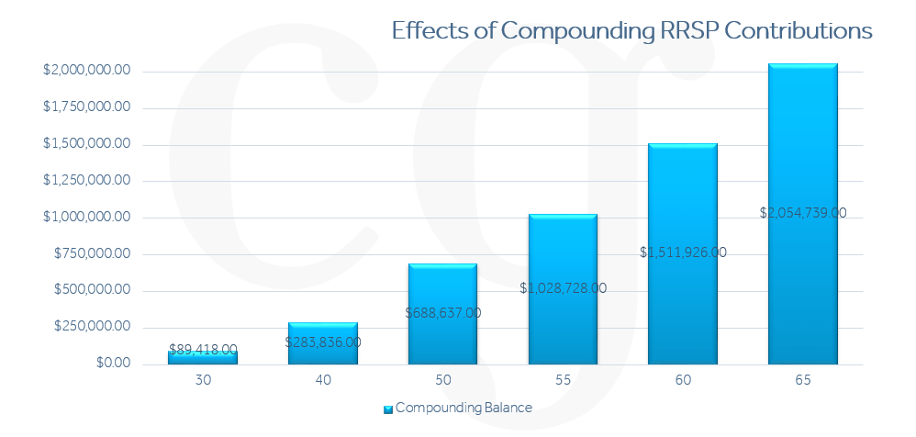
Compounding Growth Chart
Based on an individual earning $60,000 a year and contributions starting from age 20 at 10% of income, 5% RoR and annual raises of 1.9% inflation
Source: https://www.canaccordgenuity.com/wealth-management-canada/calculators/retirement-planner/

Slide 18
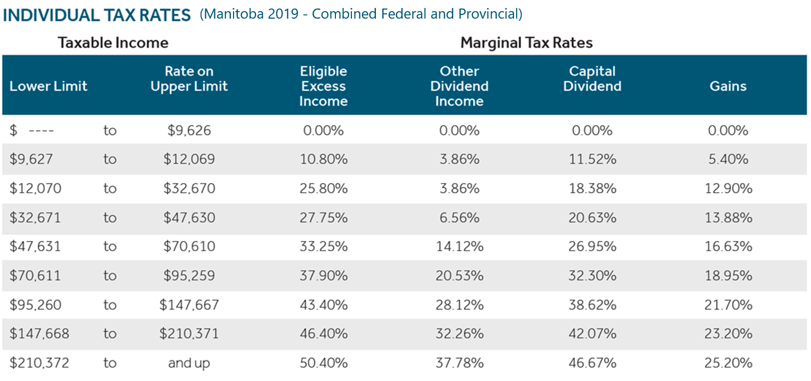
Current Manitoba Tax Rates

Slide 19
RRSP Withholding Taxes
Mandatory Withholding Taxes on RRSPs / RRIFs
Withholding Tax % based on Withdrawals
10% = <$5000
20% = $5000.01 - $15,000
30% = > $15,000.01
You can elect additional withholding taxes to avoid large unexpected tax bills

Slide 20
Maximizing your TFSA
(Tax-Free Savings Account)
Same investment options as your RRSP
Current Lifetime Contribution limit of $69,500
Annual contributions $6000
Great source of additional funds to supplement your lifestyle need without taxation!
Liquidity!

Slide 21
Should I contribute to an RRSP or TFSA?
Ideally BOTH if you can!
Use your RRSP tax refund to put into TFSA
Great to have a balance of tax-free and taxable funds in retirement
Remember TFSA funds are marked for retirement if that is your goal
Is your current tax bracket higher than your retirement tax bracket?
Income < $47,630 = TFSA Priority
Income > $47,631 = RRSP Priority
But in Reality, it depends on YOUR financial plan!

Slide 22
Income Splitting – Eligible Income
Have each spouse in a similar tax bracket, there by reducing your overall taxes paid as a couple.
Before age 65
Periodic payments received directly from a defined benefit pension plan.
Once you are 65 or older during the year
Periodic payments received directly from a defined benefit pension plan.
Payments received from a RRIF, LIF, or LRIF.
Payments received from annuities purchased with the proceeds of an RRSP, RRIF, LIF, or LRIF.
The taxable portion of payments received under certain types of annuity contracts purchased with non-registered funds (typically prescribed annuity contracts).
Funds from RRSP withdrawals do NOT qualify for income splitting!

Slide 23
Income Splitting Illustration
$ 4063 savings! $5703 savings! $7734 savings!
*Based on estimated Manitoba Tax rates using EY.com tax calculator and assuming a full 50/50 income split. OAS claw back and tax credits not factored into calculations. Information is intended for illustration purposes and not implied tax advice.

Slide 24
Retirement Planning
How much does your current lifestyle cost you?
How will this change in Retirement?
Any other income sources?
Will you have debt?
How will you spend your free time?
Upcoming major expenses?
Any financial dependents?

Slide 25
Importance of Retirement Planning
Optimize your income splitting
What order should you draw down your retirement assets?
Effective RRSP Meltdown
Tax efficiency
Improved Investment Management
Identify your goals
Peace of Mind!

Slide 26
Drawdown Strategy
What order should you draw down or access your retirement nest egg?
Should you convert your RRSP to a RRIF prior to age 71?
Should you take your RRSP first before funds from a corporation?
What tax bracket are you in and how might that change over retirement?
As part of our comprehensive analysis, we want to determine the most tax efficient way to access your funds both in the current year and over your lifetime. Drawing these assets in the right order can result in a substantial long term tax savings….and don’t forget to maximize your TFSA every year too!

Slide 27
Investment Planning in Retirement
If you are fortunate enough to have several buckets of retirement proceeds, such as RRSPs/RRIFs, TFSAs, Non-Registered accounts and Corporate Investments, we want to ensure the incomes generated are tax efficient.
Most often an important factor is having your investments generate a steady income stream of tax efficient income...but we can’t forget about growth in retirement, after all the cost of living increases annually!
What rate of return do you need to achieve your lifestyle goals over the next 20, 30 or even 40 years of retirement?

Slide 28
Should all your investments hold the same assets?
Think of the tax consequences of the potential returns on your investments:
Interest Income (highest tax rate on the income)
Dividends (dividend tax credit)
Capital Gains (only half is taxed)
Return of Capital (not taxed in year received – tax deferred)
This is something we do automatically for clients ! Most portfolios we see don’t!

Slide 29
Market Update

Slide 30
What’s Going on in the Market
Covid-19 (Coronavirus)
Pipeline Protests
US-China Trade War
Oil price volatility
Corporate Earnings
Household Debt at all time highs
Unemployment
Recession?

Slide 31
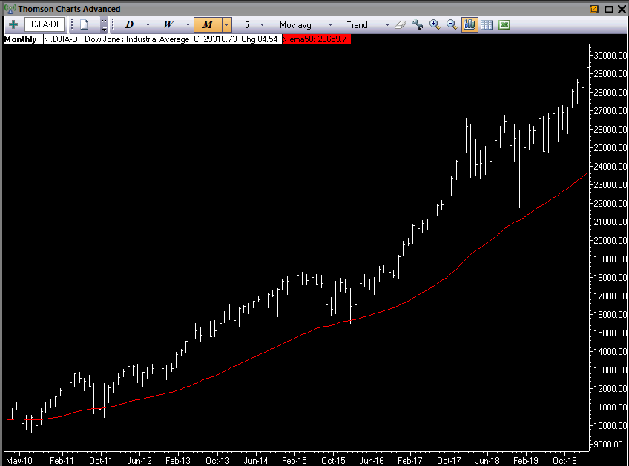
A Very Strong Decade

Slide 32
Portfolio Management

Slide 33
What’s a fiduciary obligation?
“A Fiduciary obligation is the highest standard of care that exists at law in a client/professional relationship. It requires the fiduciary to act at all times for the sole benefit and interest of the client. It’s an enhanced level of protection for the client.”
IIROC
Investment Advisor
Fiduciary Obligation
Portfolio Manager
MFDA
Financial Advisor

Slide 34
How it works
Step 4
Step 3
Step 2
Step 1
You join the award-winning Tetrault Wealth Advisory Group as a client and benefit from best-risk adjusted returns and world-class advice & service.
Schedule in person meeting (or via Skype/Zoom). We discuss potential Portfolio Allocation, Fees, Return Expectations, Cash Flow, Volatility, Alternatives.
We identify the areas you need help with (Investment, Tax, Insurance, Estate & Retirement).
Discovery call. We get to know you and you get to know us.

Slide 35
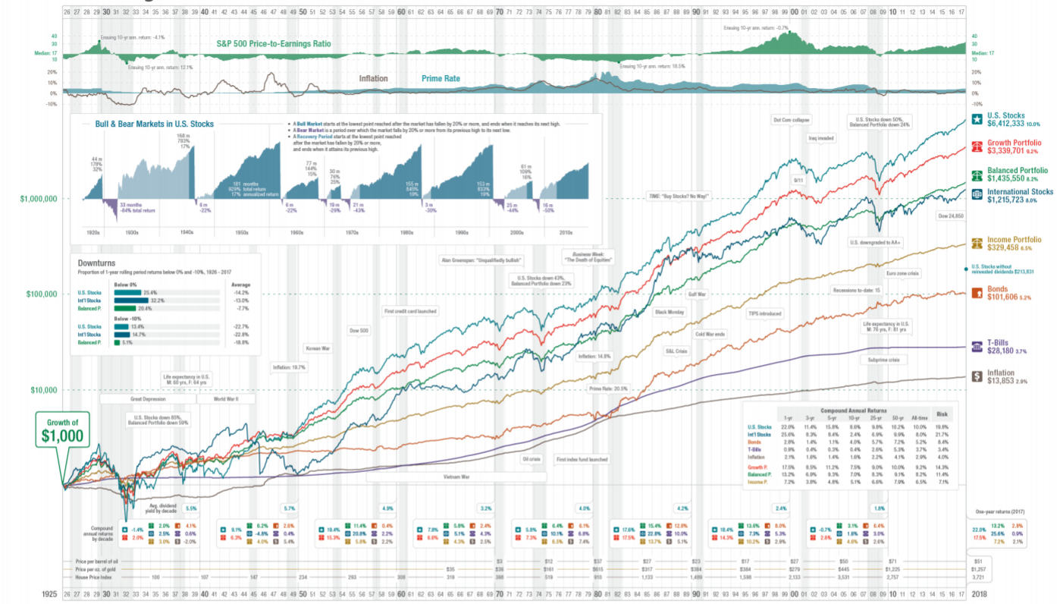

Slide 36
Why Asset Allocation Matters For Retirement?
Bonds vs. Stocks performance over time.
Why do people actually own Bonds?
Volatility vs. Risk.
We evaluate the current and future upside and downside of asset classes.
Why Alternatives?
Bottom Line: Proven track record and asset classes that perform in all markets.

Slide 37
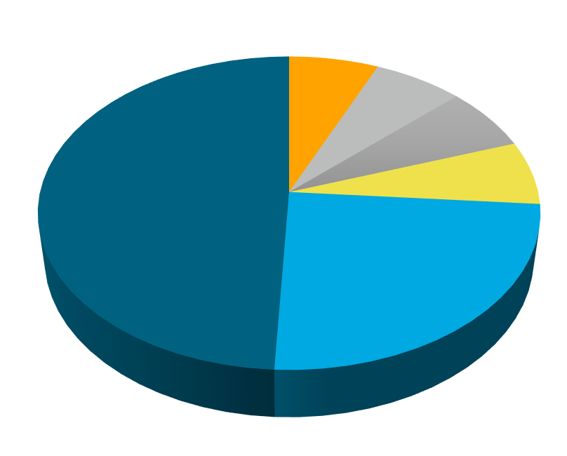
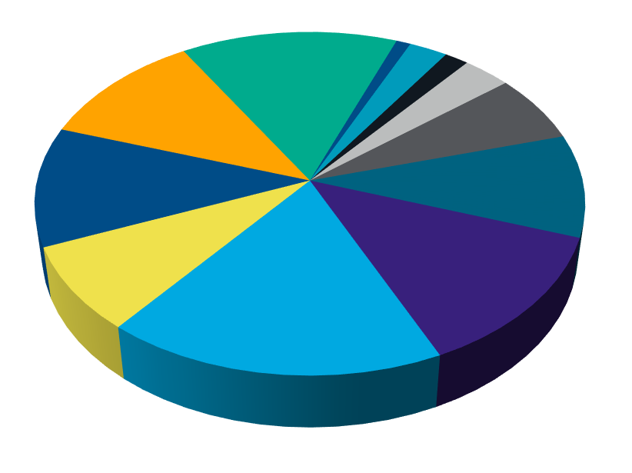
Traditional Portfolio Theory
(60% Growth, 40% Income)
Standard 60/40 Portfolio
Tetrault Wealth 60/40 Portfolio
Cookie Cutter Approach
Our Approach

Slide 38
Why Alternatives

Slide 39
Alternatives – A Proven Asset Class
Alternatives can be both privately sourced Real Estate, and publicly offered institutional deals. They can also be Private Equity, Farmland, and a whole other potential offerings that are not traditional stocks or bonds.
Most of the alternatives we use have liquidity build into them, which gives us flexibility in liquidating and moving to other asset classes.

Slide 40
Alternatives – Advantages
Alternatives have several key advantages:
Extremely tax efficient
  Payment Classified as Return of Capital – not taxable in year it is received. Becomes a deferred Capital Gain, eventually be taxed at 25%
Significantly enhanced diversification
Very low correlation to traditional stock markets
Very strong historical returns for the asset class

Slide 41
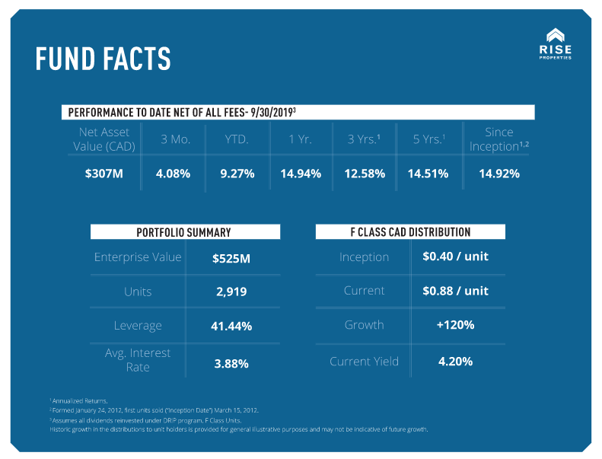
Example – Rise Properties

Slide 42
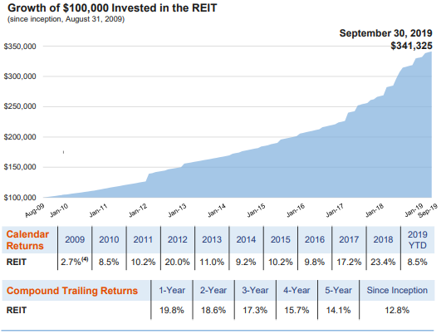
Example – Centurion REIT

Slide 43
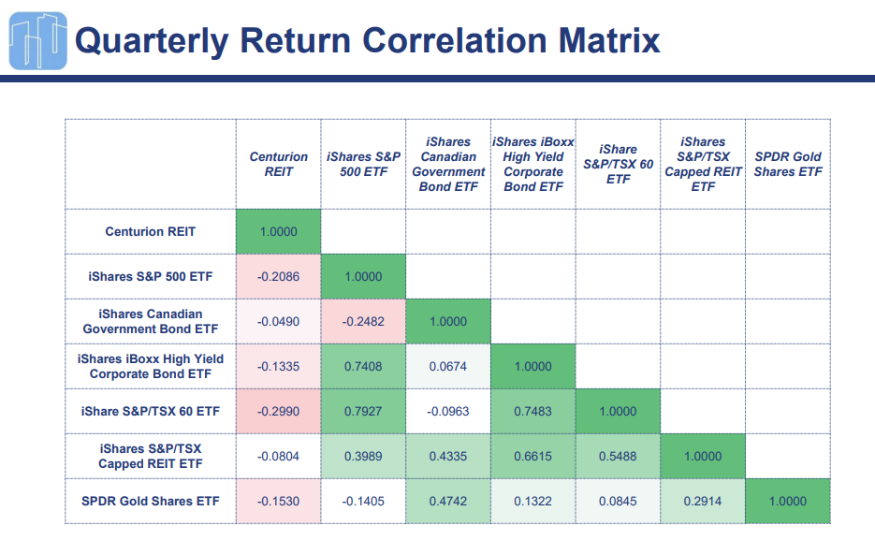
Uncorrelated Asset Class

Slide 44
Financial Planning
&
Services

Slide 45

Wealth & Estate Planning
  Planning Areas to Address
  Estate Planning (Wills, POA, Health Care Directive)
  Estate Tax planning
  Cottage Succession or Rental Properties
  Insurance Needs Analysis
  Emergency Funds Review
  Education Savings
  Debt Management
  Retirement Planning
  Tax Optimization
  Financial Education
  Business Succession & Corporate Tax Strategies
  Core Services Offered
  Financial & Estate Planning
  Insurance (Life, Disability, Critical Illness and Benefits)
  Referrals to Lawyers & Accountants
  Charitable Foundations
  Additional Services Offered
  Mortgage Brokerage

Slide 46
Financial Planning

Slide 47






Financial Planning Process
Gordon B Laing & Associates
CHIMP
Miller Thompson
Concentra Trust
External Partners
BDO
Manulife Private Banking
Engagement
Referral
Discovery Meeting
Analysis
Plan Creation
Presentation Meeting
Follow UP
Annual Review
Draft
Internal Partners
Investment Banking
ICP
Cash Management
Select Portfolios
Insurance

Slide 48
Summary

Slide 49
Benefits of Partnering with our Team!
Learn & apply proven real-world advice from a national award-winning firm.
Peace of mind & less stress.
More time to enjoy the things you want to do.
Protect your capital, generate income & get great risk-adjusted returns.
Secure your family’s future.
Difference between retiring comfortably or continuously doubting your financial situation.
Dealing with a Portfolio Manager IIROC licensed, who owes you a fiduciary duty along with a in-house Certified Financial Planner
Canaccord Genuity Wealth Management is a member of the CIPF.

Slide 50
Questions!

Slide 51
Thank you!

Slide 52




CONTACT INFO
www.RobTetrault.com
rterault@cgf.com
(204) 259-2859
https://www.linkedin.com/in/robtetrault/
Rob Tetrault – Tetrault Wealth
https://www.facebook.com/RobTetrault.TetraultWealth/
robtetrault_tetraultwealth

Slide 53
Disclaimer
  This material is provided for information purposes only and is intended for distribution in those jurisdictions where subsidiaries of Canaccord Genuity Group Inc. (together, “Canaccord Genuity”) are registered as advisors or dealers in securities. Any distribution or dissemination of this material in any other jurisdiction is strictly prohibited. The information does not constitute an offer or solicitation in any jurisdiction in which such an offer or solicitation is not authorized, or to any person to whom it is unlawful to make such an offer or solicitation. This is not, and under no circumstances should be construed as, a solicitation to act as a securities broker or dealer in any jurisdiction by any person or company that is not legally permitted to carry on the business of a securities broker or dealer in that jurisdiction. This material is prepared for general circulation to clients and does not have regard to the investment objectives, financial situation or particular needs to any person. Clients should obtain advice based on their own individual circumstances before making an investment decision. Any client wishing to effect any transactions should do so through a Canaccord Genuity qualified salesperson in their jurisdiction of residence.
  The information contained herein has been compiled by Canaccord Genuity from sources believed to be reliable, but no representation or warranty, express or implied, is made by Canaccord Genuity or any other person to its fairness, accuracy, completeness or correctness. To the fullest extent permitted by law, neither Canaccord Genuity nor any other person accepts any liability whatsoever for any direct or consequential loss arising from any use of the information contained herein.
  All material presented in this document, unless specifically indicated otherwise, is under trademark and copyright to Canaccord Genuity. None of the material, or its content, or any copy of it, may be altered in any way, or transmitted to or distributed to any other party, without the prior express written permission of Canaccord Genuity.
  Copyright © Canaccord Genuity Corp. 2018. – Member IIROC/Canadian Investor Protection Fund Copyright © Canaccord Genuity Limited 2018. – Member of the London Stock Exchange, authorized and regulated by the Financial Conduct Authority.
  Copyright © Canaccord Genuity LLC 2018. – Member FINRA/SIPC
  Copyright © Canaccord Genuity (Australia) Limited 2017. – Authorized and regulated by ASIC.
  CAUTIONARY STATEMENT REGARDING FORWARD-LOOKING INFORMATION
  This document may contain certain “forward-looking information” (as defined under applicable securities laws). These statements relate to future events or future performance and include management’s expectations, beliefs, plans, estimates, intentions, and similar statements concerning anticipated future events, results, circumstances, performance or expectations that are not historical facts, business and economic conditions and Canaccord Genuity Group LLC’s (the “Company”) growth, results of operations, market position, ability to compete and future financial or operating performance of the Company, performance and business prospects and opportunities. Such forward-looking information reflects management’s current beliefs and is based on information currently available to management. In some cases, forward-looking information can be identified by terminology such as “may”, “will”, “should”, “expect”, “plan”, “anticipate”, “believe”, “estimate”, “predict”, “potential”, “continue”, “target”, “intend”, “could” or the negative of these terms or other comparable terminology. By its very nature, forward-looking information involves inherent risks and uncertainties, both general and specific, and a number of factors could cause actual events or results to differ materially from the results discussed in the forward-looking information. In evaluating these statements, readers should specifically consider various factors, which may cause actual results to differ materially from any forward-looking statement. These factors include, but are not limited to, market and general economic conditions, the nature of the financial services industry, the risks and uncertainties discussed from time to time in the Company’s interim and annual consolidated financial statements and its Annual Information Form filed on www.sedar.com. Readers are cautioned that the preceding list of material factors or assumptions is not exhaustive. Except as may be required by applicable law, the Company does not undertake, and specifically disclaims, any obligation to update or revise any forward-looking information, whether as a result of new information, future developments or otherwise.

